Slide 1
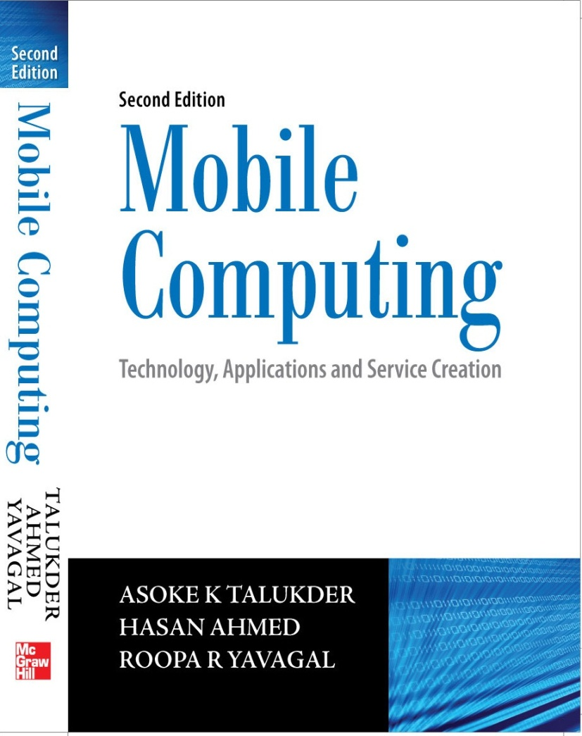
Notes#10
Client Programming

Slide 2
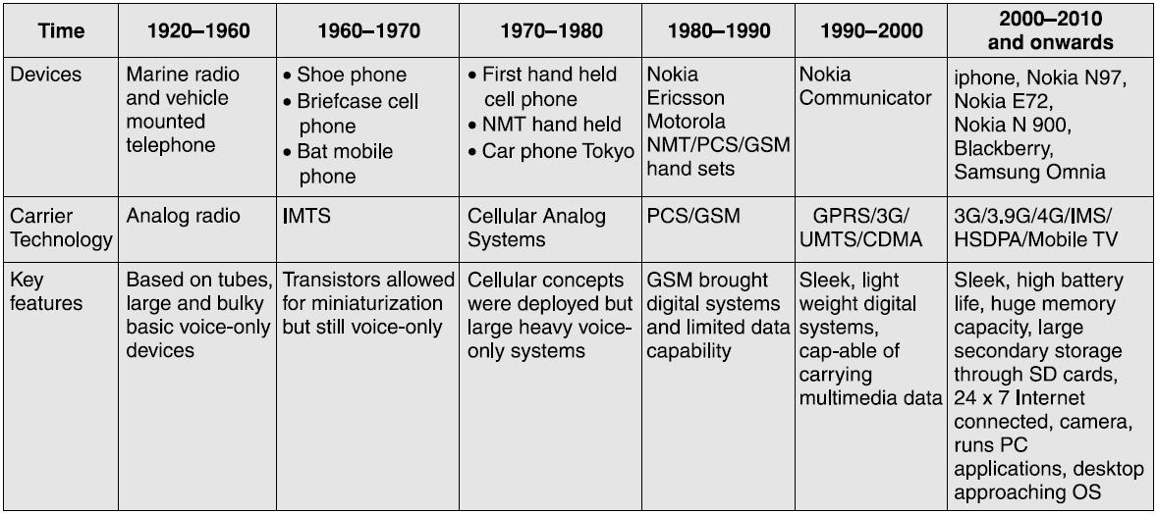
Moving beyond the desktop
Devices offer many permutations and combinations of features leading to ‘one-size-fits-all’ devices.
We shall briefly review two independent streams of developments one leading to mobile phone and the other to PDAs.

Slide 3
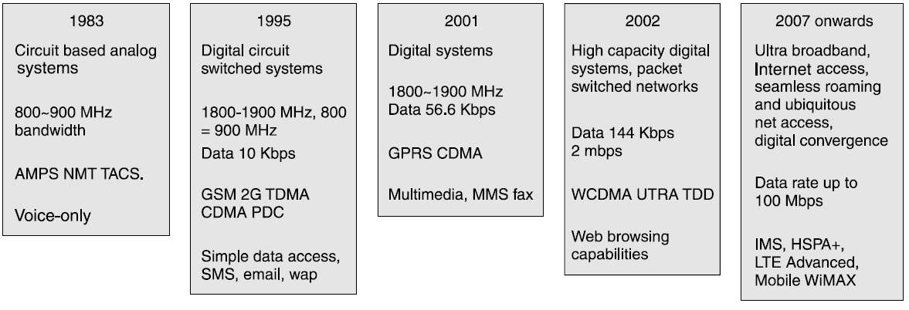
Evolution of Cellular Technology

Slide 4
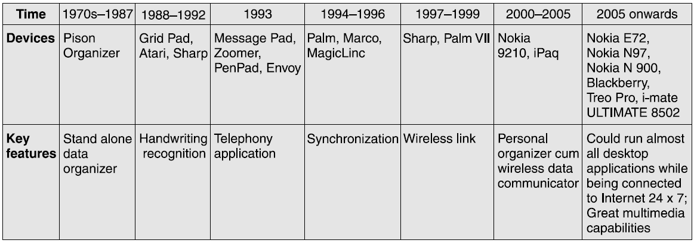
Personal Digital Assistants
Its major functionality is related to the storing, accessing and manipulating data.

Slide 5
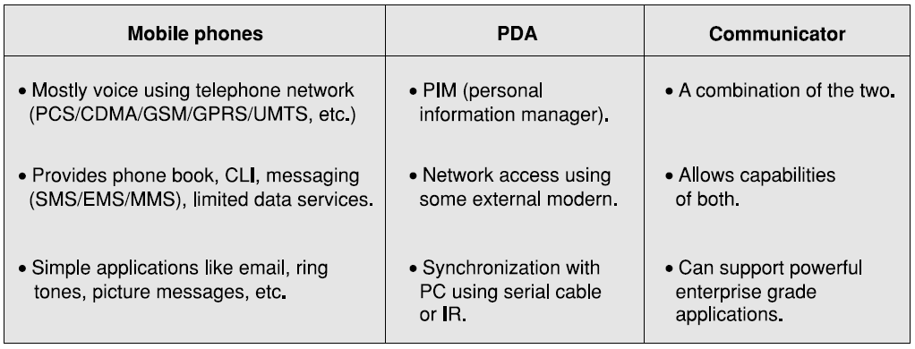
Capabilities of different devices

Slide 6
Structure of Mobile Device
Programming at a device level is cumbersome and, generally, not advisable.
We need some level of abstraction on the bare hardware. This layer of abstraction is the device operating system. Most devices provide some kind of programming environment.

Slide 7
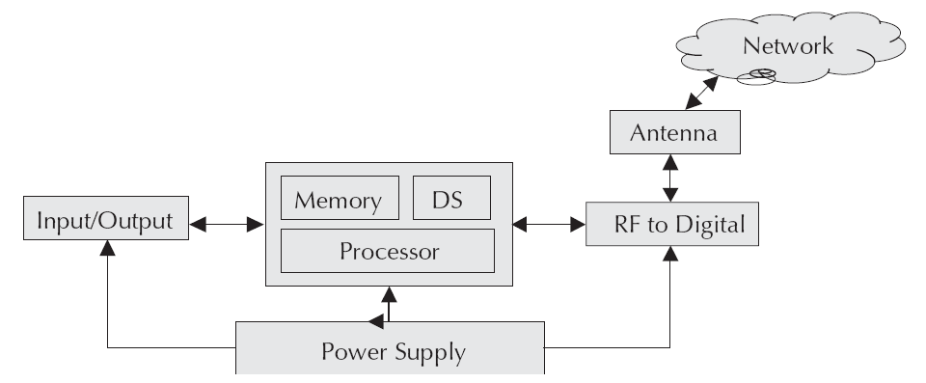
Hardware Overview
Modern digital devices have a MIPS (million instructions per second) capability to process information (voice/data) stream and consist of a microprocessor, a power source, a signal converter, an I/O unit and some memory (both persistent and volatile).

Slide 8
Mobile Phones
The following are the main parts of a typical mobile phone:
Antenna is the signal reception unit.
Circuit board is the control unit of the system.

Slide 9
Mobile Phones
Display unit is the output unit, generally, a Liquid Crystal Display (LCD) panel.
Keyboard (qwerty or T) which is the input unit.
Microphone which facilitates speech transmission.
Speaker which is microphone’s counter part.
Battery which is the source of electrical energy.

Slide 10
Circuit Board Chips on a Mobile Phone
The analog-to-digital and digital-to-analog conversion chips are entry and exit points to the phone. This chip converts analog network signals to digital for the phone to process and reverse.
The microprocessor controls and co-ordinates the handset functions which include user I/O and network interfaces that
include communication with the base station.
The ROM and Flash memory chips provide storage for the phone’s storage requirements.
The Digital Signal Processor (DSP) is a highly sophisticated chip that manages the signal manipulations.
The RF chip manages the signal channels while the power section is responsible for power management and recharging.

Slide 11
Personal Digital Assistants (PDAs)
The PDAs, unlike the phones evolved from the PCs. They have a similar architecture as most PCs have namely a microprocessor, an I/O mechanism, memory, a wireless or IR port and, of course, a power source generally a battery.
They typically have an operating system and mimic the applications on the desktops like address book, e-mail, etc. and, hence, need to be able to synchronize with the applications on the PC.
PDAs are considered a portable extension to the desktop

Slide 12
Components of a PDA

Slide 13
Microprocessor in a PDA
This unit is the control unit and is responsible for initiating and co-coordinating the PDA’s functions.
Owing to intrinsic device limitations, PDAs use cheap low end processors which, though, very basic (about 16-75 MHz capacities) are sufficient for the requirements of a PDA.
However, this is an important consideration for application developers who consistently have to ensure that they do not overload the processor leading to a performance degradation and poor user experience.
This is one of the factors which decides which part of processing should be performed on the device and what should be shifted to a backend server.

Slide 14
OS and Memory in a PDA
OS has a multitude of responsibilities very similar to those in the desk-top environment. The PDA operating systems, however, are fairly simple having fewer instructions and smaller footprints.
PDA has a solid state memory like Static RAM or Flash memory and these days removable memory cards are also in use.
It is common to have about 2 MB of memory. It is used to store the OS and application programs and these remain intact even when the machine shuts down.
The user data however is stored in RAM.

Slide 15
Batteries and Display in a PDA
PDAs use rechargeable lithium, nickel-cadmium or nickel-metal hydride batteries that last for about 2 hours on an average.
Major culprits that drain batteries are additional memory, color LCD display, high end features like voice recording, camera, music player, etc.
PDAs use advanced power management systems to extend the battery life. It is important for application developers not to start infinite loops or polling as this can potentially interfere with the system’s power management.
Liquid Crystal Display screen of a PDA is its I/O interface and is used for both input and output. The display may be grayscale (16) or color (65,536).

Slide 16
Inputs and I/O in a PDA
PDAs, mostly, use a stylus and touch screen in combination with a handwriting recognition program. Most also have buttons to bring up frequently used applications. This is similar to using keyboard short-cuts. Some high end devices may actually boast of a miniature ‘qwerty’ keyboard but these are exceptions and not the rule.
PDA must be able to communicate with a PC. This communication is called data synchronization or syncing and is typically done through a serial or USB port. This can be done through a cable or a cradle. These days most come with an infrared port, Bluetooth port and offer telephone modem accessories to transfer files to and from a network.

Slide 17
Design Constraints for Handheld Devices
Low end processors
Small screen size
Cumbersome input device
Limited battery power
Memory limitations

Slide 18
Processing Power in Handheld Devices
The processing speeds start at about 16 MHz. Heavy duty computation like encryption key generation is a heavy drain on the device’s resources.
While designing a device resident client, architects and developers always have to walk the tight rope. Too many computations on the client while allowing for faster response eat into valuable memory. Shifting everything to the server leads to poor response, which is a frustrating experience for the user. So extreme caution has to be exercised.

Slide 19
Screen Size in Handheld Devices
Most handhelds have a small screen limiting the information that we can display at one time. Hence, screens should be designed very carefully taking care to remove all extraneous information.
It is a good practice to limit scrolling to two screens down. Navigation should be easy using single click as far as possible. A general rule of thumb is that the depth of navigation should be at most four clicks.

Slide 20
Inputs in Handheld Devices
Most devices sport a stylus or T keypads or a very small ‘qwerty’ keyboard where keying in long strings is a pain. Hence, inputs should be kept to the minimum. As far as possible we should try to device inputs as a single click kind of option.

Slide 21
Application Load Time and Battery in Handheld Devices
Generally, users switch on their handhelds for short durations. For Example, often it is to retrieve a contact number. The load time for applications should be low as the users would not like to wait for the application to load each time.
One of the keys to the success of the application is long battery life. Activities like serial or IR communications, sound extended animation and other tasks that use the CPU for long periods tend to consume large amounts of power.

Slide 22
Memory and Storage in Handheld Devices
All handheld devices have limited storage space.
Under such circumstances optimization is crucial. The optimization mantra is heap first, speed second and code size third.
All devices provide some amount of persistent storage. However, this is very limited. Different devices organize this in different ways.

Slide 23
Backward Compatibility in Handheld Devices
Backward compatibility is a key issue as the devices have evolved rather rapidly in a very short span of time and users are not expected to upgrade their system every time an advanced version becomes available.
Hence, to gain wider acceptance, applications have to be written in a manner that they will run on all versions of the device and, at the same time, give the users of a later version better functionality.

Slide 24
Application Size in Handheld Devices
Applications need to be stored on the devices. Most devices will have an upper limitation on the size of executables. This needs to be taken into account during the design phase itself.
There is no ideal way to design a device resident client. All clients, which are done well, evolve over a period of time involving changes and undergo several iterations before a satisfactory mix is obtained.
The new technologies are enabling mobile phones to be a combined camera, video camera, computer, stereo, radio and a host of other things. This has lead to an enormous potential for applications. The development of software applications and other key technologies have enabled subscribers to use the handset to connect to the Internet.

Slide 25
Clients in Handheld Devices
Thin clients are generic in nature and cater to a wide range of sources. They are similar to the web browsers. Communication from the server is mainly based on some flavor of Markup Language (ML). The server needs to send large amount of display information to the client to adequately represent data, chocking up the transmission channel. Thus, the thin client offers generality at the cost of bandwidth. This is a major consideration especially in networks where the users pay for the data and not call time.
Thick clients are the ones where intelligence resides in the device and a call is made to the server only for data. Computation is done locally. While this approach resolves the bandwidth problem, it introduces two more problems, namely, the size of the
application on the device and distribution of the application when an update or fix happens.

Slide 26
Clients in Handheld Devices
Thin plus or semi thick clients lie somewhere in between thin and thick clients. How thick or thin is decided based on the functionality of the application, the bandwidth availability and cost constraints.

Slide 27
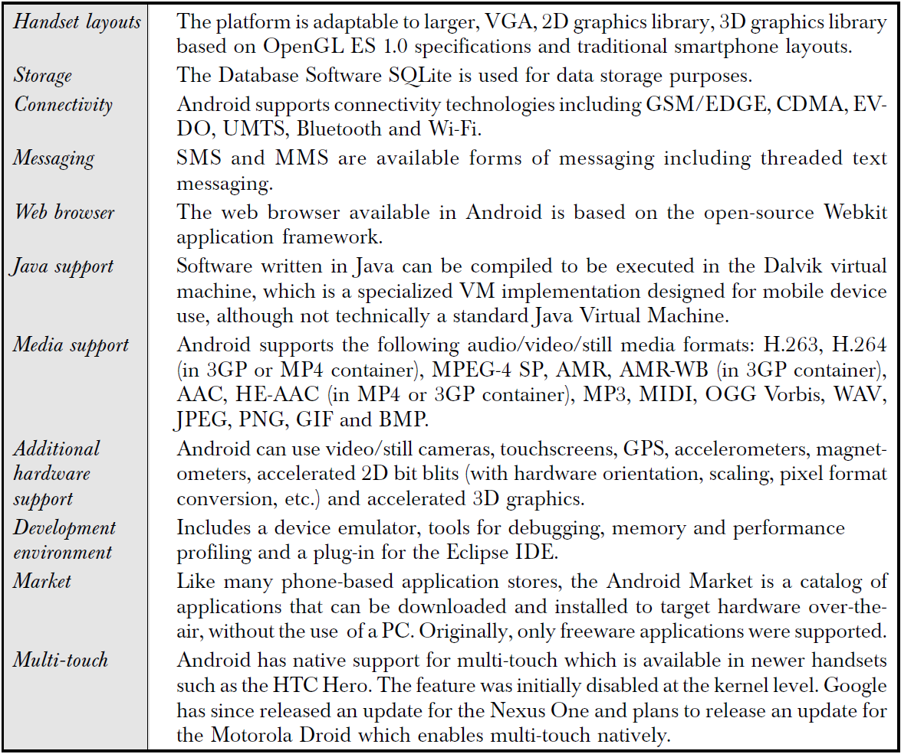
Recent Developments – Features of Android OS

Slide 28
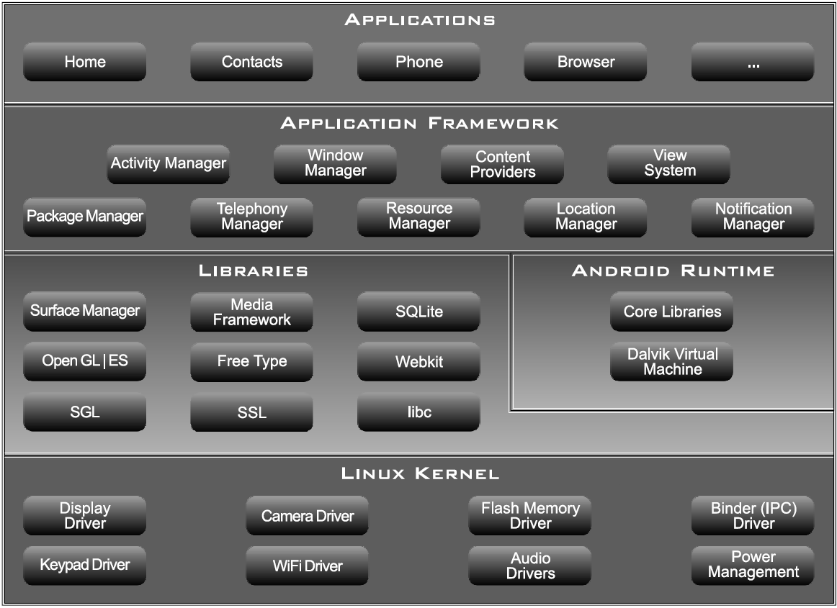
Recent Developments – Components of Android OS

